Slide 1
PRESENTED BY
MUAMMAD ABUBAKER
FATIMA AFSAR
FAHAD NAEEM
ZAINAB TAHIR
JAWAD RAFIQ

Slide 2


Slide 3
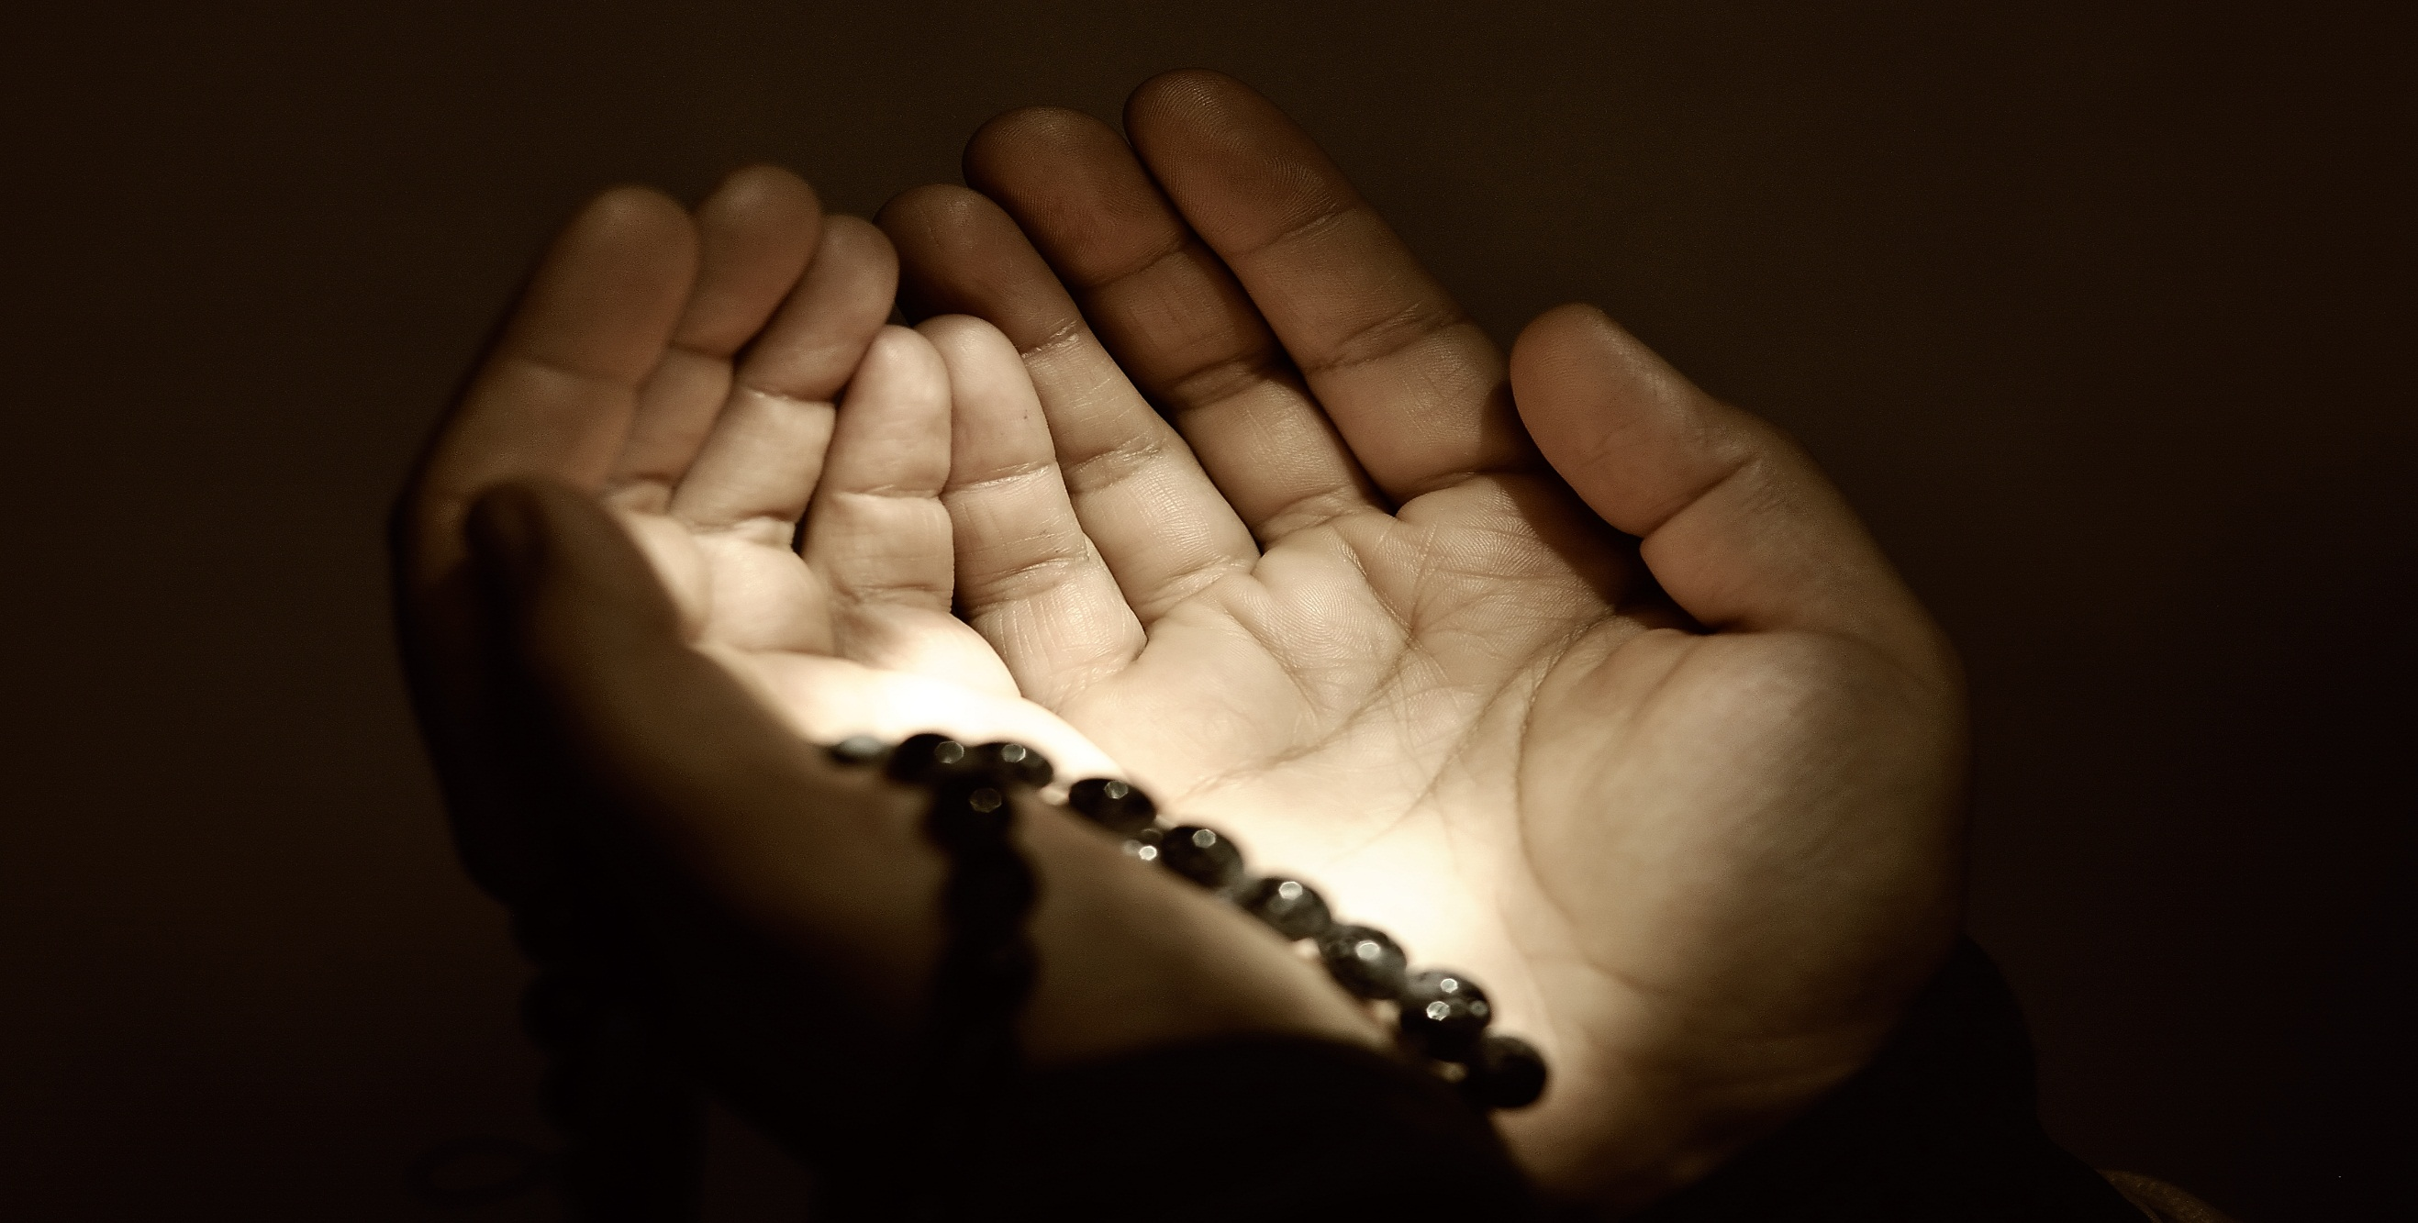
FEAR OF ALLAH

Slide 4
Taqwa (fear of Allah)
Taqwa is an Islamic term for being conscious and cognizant of God, of truth, of the rational reality, piety , fear of GOD. It is often found in the Quran.
Taqwa is very comprehensive word. It is inclusive of all that is good . Its real meaning is to fulfill what is obligated by Allah(SWT) and to refrain from what Allah (SWT) has forbidden. It is to be done sincerely for him and for his love. It is done to be attain His reward and with the fear of His chastisement.

Slide 5
Taqwa in the light of hadith
Taqwa (translated here as ‘fear’) comes from the root word waqaaya, which means “he protected” or “to protect”. When the word Taqwa is used with respect to Allah (SWT), as in this hadith, it means that one must fear and protect oneself from the anger and punishment of Allah (SWT).

Slide 6
Four tools to gain Taqwa
Sincere
Ibadah
Sincere
Dua
Taqwa
observe
The
Sunnah
Sincere
intention

Slide 7
How to achieve Taqwa
Tilawah of
Quran
Ziker of Allah
Saleh deeds
Be with
Saleheen
Gain Elm
Be aware of
Shitan
Be humble
sincerity
Focus on life purpose
Remember
Death

Slide 8
Benefits of Taqwa
God-fearing nature
Self- Discipline
Taqwa (Self –
Restraint)
Afterlife Accountability
Responsibility
patience
obedience
Self-control
Purification of soul

Slide 9
Taqwa in Hadiths
the prophet (PBUH) said ,
“the most common thing which leads people to paradise is Taqwa of Allah and good conduct, and the most common thing which leads people to the hell fire is the mouth and private parts”. (Tirmidhi)
Atiyah As-sa’di said the prophet
said “ the servant will not acquire the status of those with taqwa until he abandons what is harmless out of fear of falling into that which is harmful”. [Ibn Majah ,Tirmizi’]

Slide 10
Taqwa in Hadith
“fear God wherever you are and follow up a bad deed with a good one and it shall erase it, and behave towards people in a gracious manners”.
I enjoin upon you the fear of God and to hear and obey, even if you are given a slaves for a ruler.
Fear God , even with half a date(in charity), if you possess not even that , then with a gracious word
O God, I ask of you guidance , Taqwa, chastity, and freedom from deeds.

Slide 11
Imam al-Ghazali divides Taqwa into three levels
First is fear and sense of awe
The second includes obedience and worship
Third is freeing the heart from sins, which is the reality and essence of Taqwa

Slide 12
Quotes on Taqwa
Good manners is part of taqwa and
you cannot have taqwa without good manners

Slide 13
Why Taqwa is important
Taqwa is the means to keep in mind the doctrines and disciplines of the faith. It strengthens the will to act upon them. It is the motive force to acquire elm (useful knowledge) and undertake ‘amal swaaleh’ ( good deeds) for the love of almighty God and to be among His loved ones.

Slide 14

THANKYOU

Slide 15

ANY QUESTION

